Slide 1
Attention Mechanism in Medical Data Mining
Shenda Hong
2018/03/22
Notes:
<number>

Slide 2
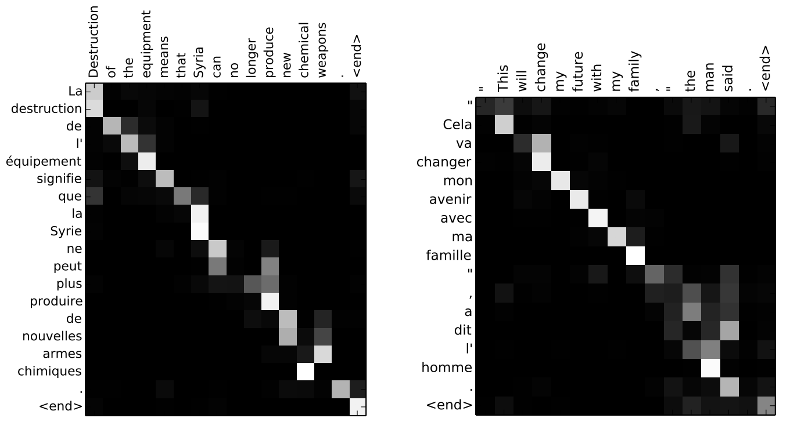
Attention Examples
NLP中的attention可视化
  为句子中的每个词赋予不同的权重，使神经网络模型的学习变得更加灵活（soft），同时Attention本身可以做为一种对齐关系，解释翻译输入/输出句子之间的对齐关系，解释模型到底学到了什么知识
<number>

Slide 3
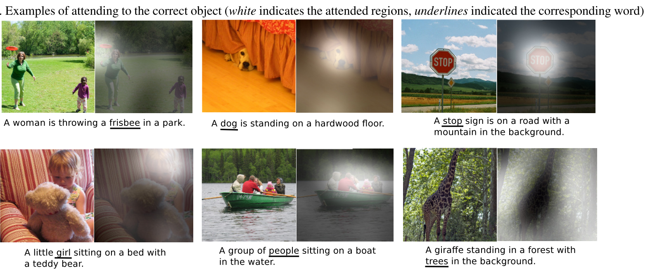
Attention Examples
图像标注中的attention可视化
  可以解释图片不同的区域对于输出Text序列的影响程度
<number>

Slide 4
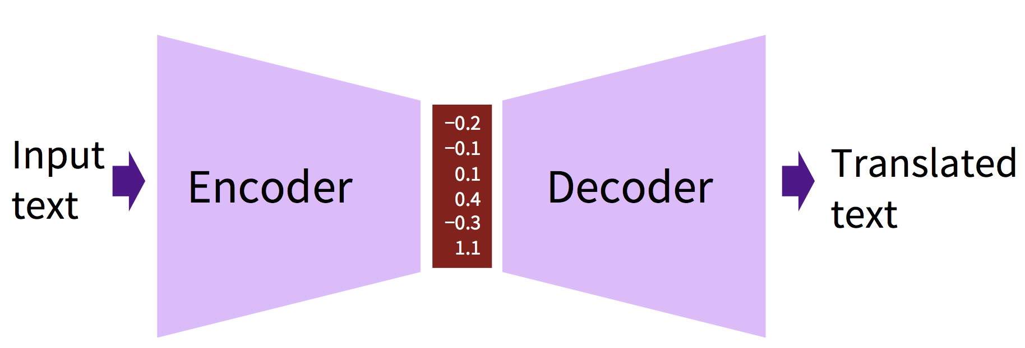
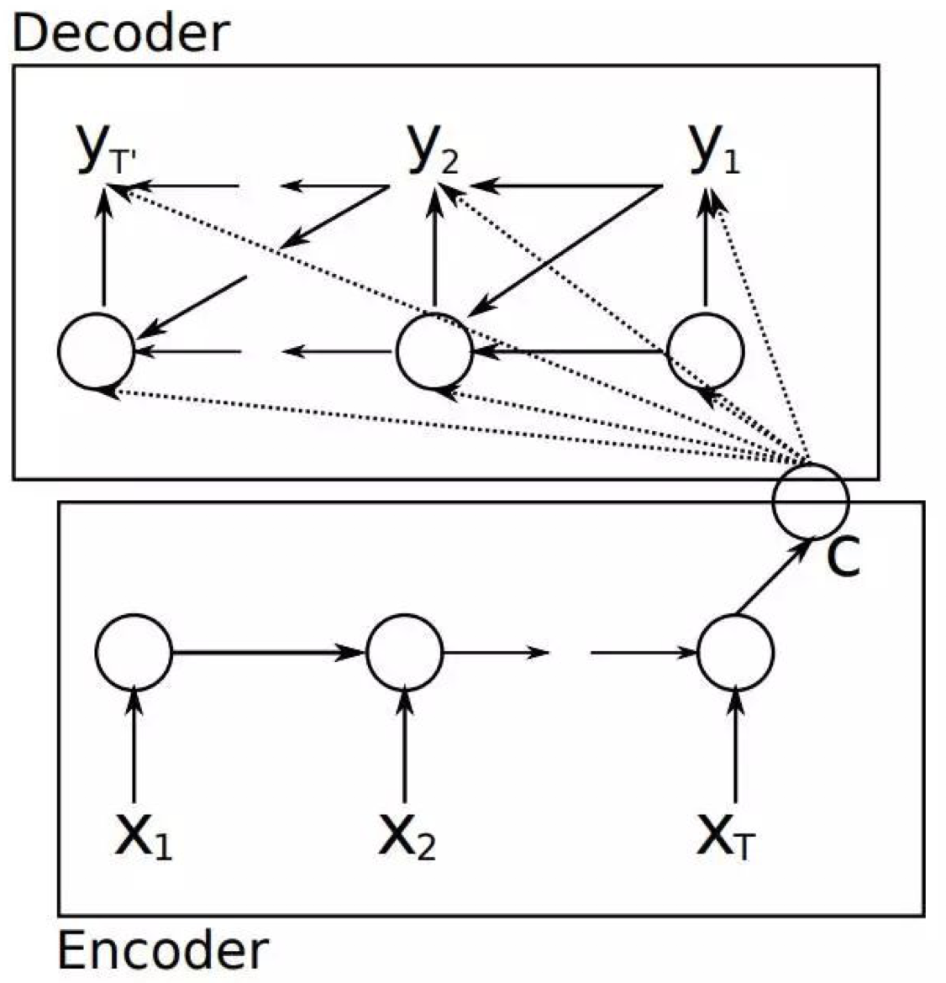
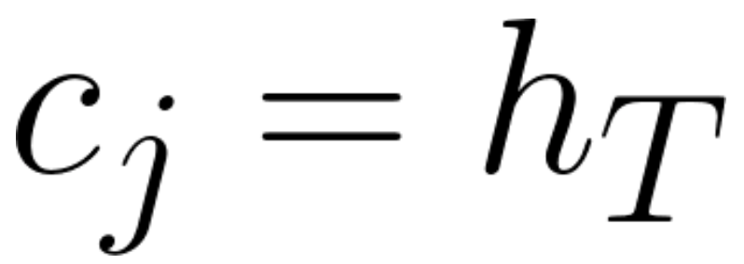
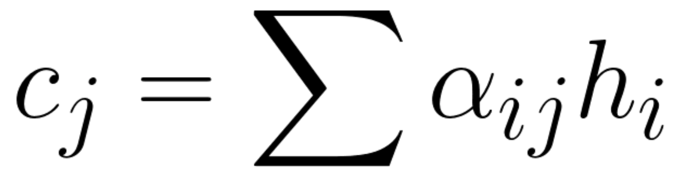
Attention with Neural Machine Translation
Encoder decoder model
<number>

Slide 5
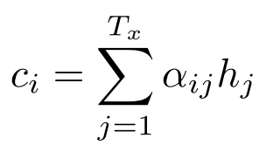
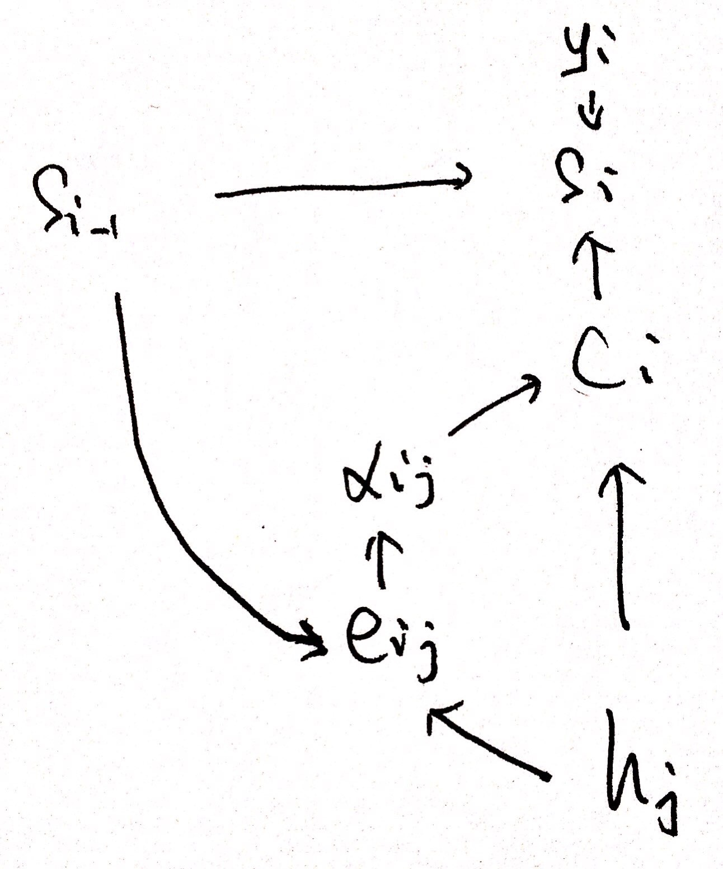
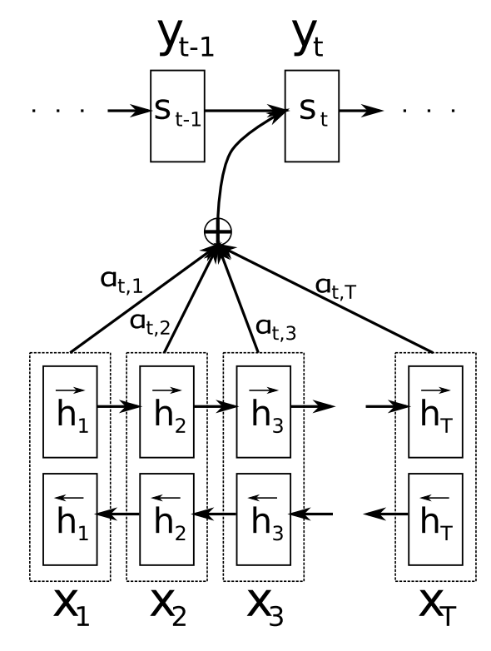
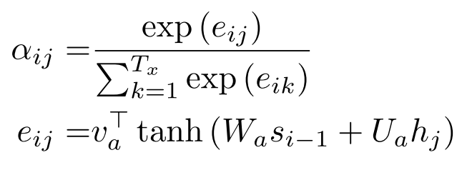

Attention with Neural Machine Translation
Encoder decoder model with attention mechanism
[ICLR 2015] Neural Machine Translation By Jointly Learning To Align and Translate
<number>

Slide 6
Attention Design
Location-based attention (self-attention)
Concatenation-based attention (additive attention)
General attention (multiplicative attention)
<number>

Slide 7
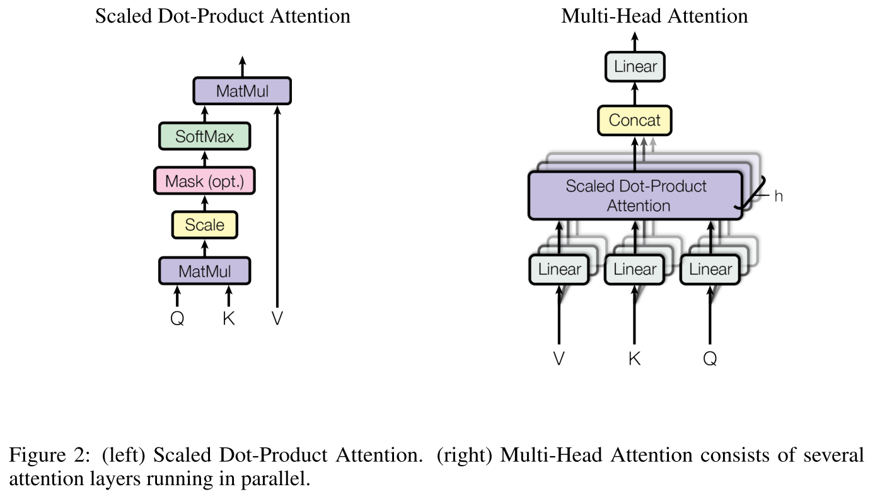
Attention is All You Need
[NIPS 2017] Attention is All You Need
<number>

Slide 8
Thanks
Q & A
Notes:
<number>

